Slide 1
Medicose Health App
Vishal Juneja

Slide 2
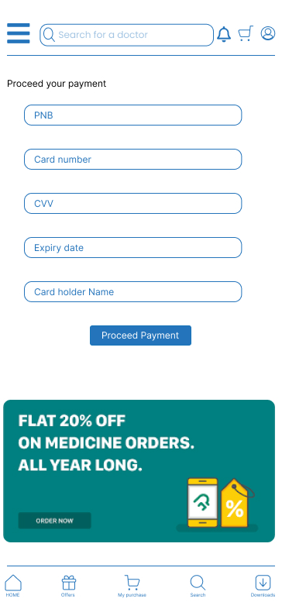
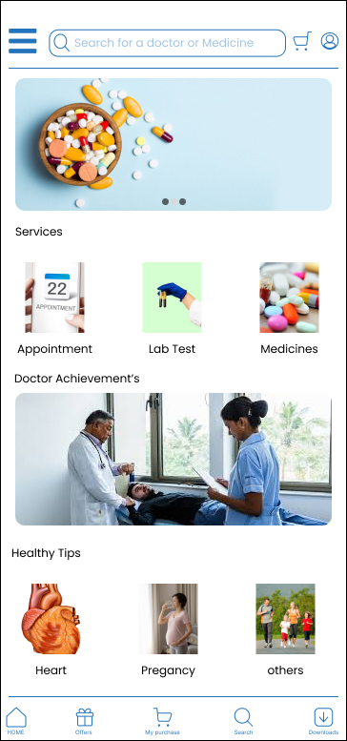
Project overview
The product:
Medicose is medical sercices app for metro and non metro cities and some of develpode towns. It’s help the peoples for saving the appointment and waitng time, amubilence services, also provide th lab and medicines Services
Project duration:
Feb 2023-May 2023

Slide 3
Project overview
The problem:
1)Waste lot of time on during appointment du to some paper work and partiality with some peoples.
2) Chemist take max charges or some black of medicine deal by chemist and may more
The goal:
1)Develop a platform where all medical services at one point
2) Save people time and ncrease the process time of medical documentation and many more

Slide 4
Project overview
My role:
UX designer designing an app for Medicose Health from scratch.
Responsibilities:
Conducting interviews, paper and digital wireframing, low and high-fidelity prototyping, conducting usability studies, accounting for accessibility, and iterating on designs.

Slide 5
User research
Personas
Problem statements
User journey maps
Understanding
the user

Slide 6
User research: summary
I conducted interviews and created empathy maps to understand the users I’m designing for and their needs. A primary user group identified through research was working on professional which are far away from home and come home on weekends or once in month.
We found that far away from home is not only problem they also face problem to find the medicine and test services in local areas. Some time they don’t found facilities at same place so they have to travel to different locations which waste the time and shorten the temper.

Slide 7
User research: pain points
2
3
1
System
Time
Accessibility
Due to working outside the home town they have only weakends to book a appointment for their parents
Due to some basic paper work in hospitals also waste time.
Not to access the all medical services at one place
Due to lack of systems in hospital some type of Discrimination happen

Slide 8
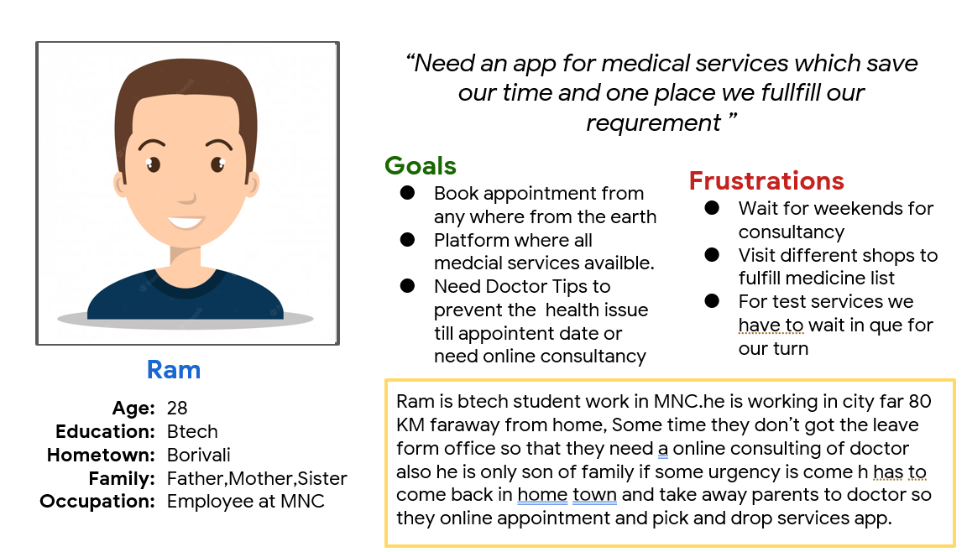
Persona: Ram
Ram is Employee in MNC work far away form home city who need online platform where he gets all services at one platform

Slide 9
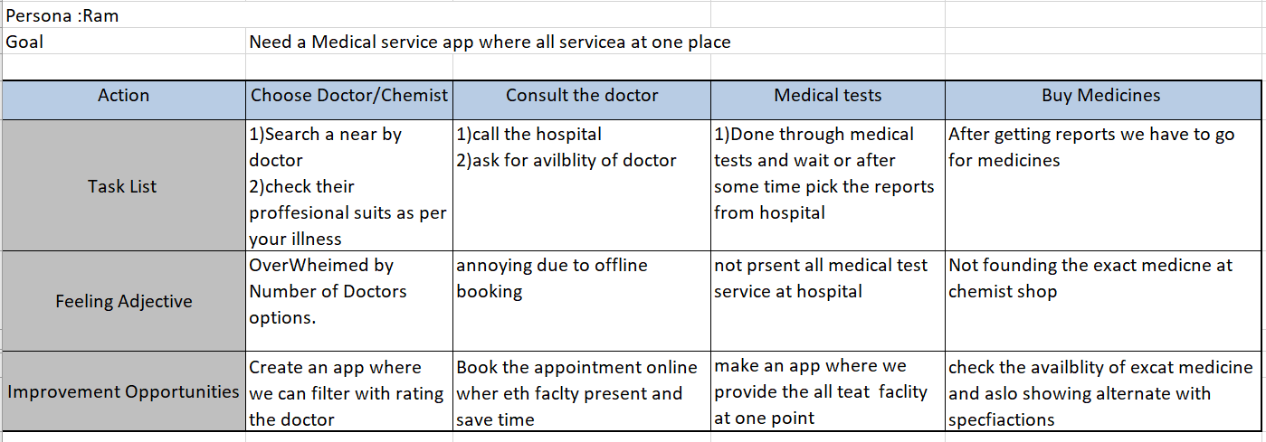
User journey map
Mapping Ram user journey revealed how helpful it would be for users to have access to a dedicated Medicose Health app

Slide 10
Paper wireframes
Digital wireframes
Low-fidelity prototype
Usability studies
Starting
the design

Slide 11
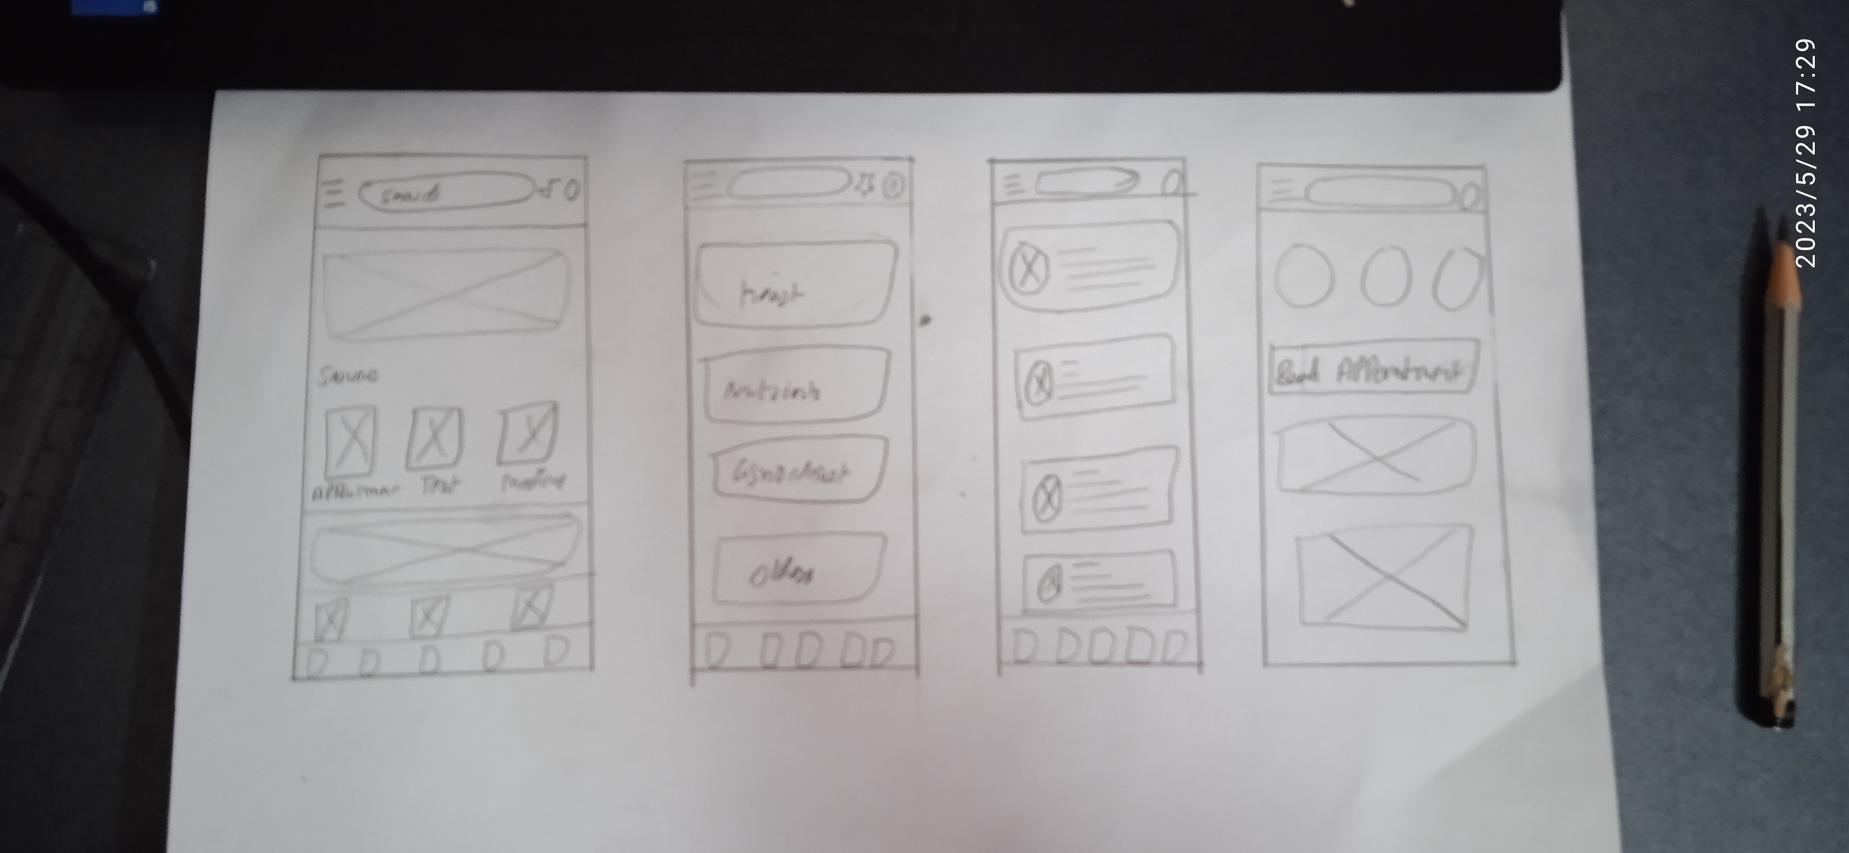
Paper wireframes
Taking the time to draft iterations of each screen of the app on paper ensured that the elements that made it to digital wireframes would be well-suited to address user pain points. For the home screen, I provide the menu button so that user can give the required service

Slide 12
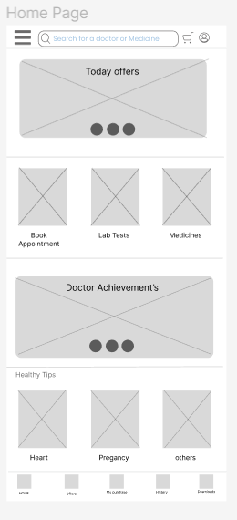
Digital wireframes
Slide show provide the daily offers and make attractive website
As the initial design phase continued, I made sure to base screen designs on feedback and findings from the user research.
Tiles makes user to chose specific services

Slide 13
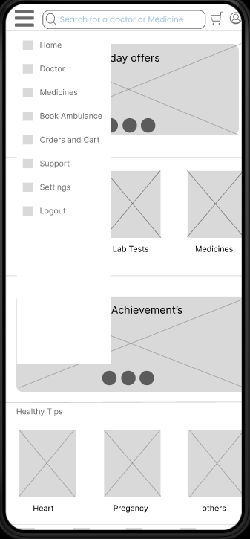
Digital wireframes
Easy access to navigation that’s screen reader friendly.
Easy navigation was a key user need to address in the designs to make the easy access of services and provide the better flow of app .

Slide 14
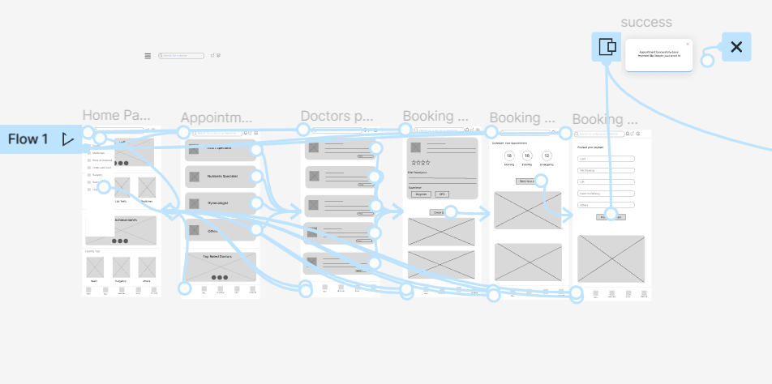
Low-fidelity prototype
Using the completed set of digital wireframes, I created a low-fidelity prototype. The primary user flow I connected was to order the appointment of specfic doctor
View the Medicose Low-fidelity prototype
Medicose Low Fidelity

Slide 15
Usability study: findings
I conducted two rounds of usability studies. Findings from the first study helped guide the designs from wireframes to mockups. The second study used a high-fidelity prototype and revealed what aspects of the mockups needed refining.
Round 1 findings
Round 2 findings
1
Use want to add doctors screen with max to min star rating
1
User want separate page for payment
2
User want notification button on top bar
2
User want also support tab in menu bar

Slide 16
Refining
the design
Mockups
High-fidelity prototype
Accessibility

Slide 17
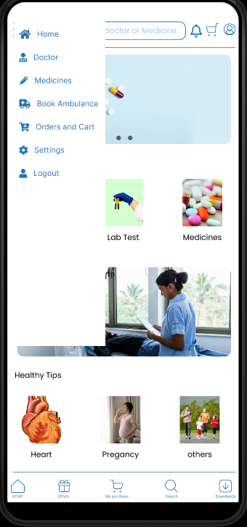
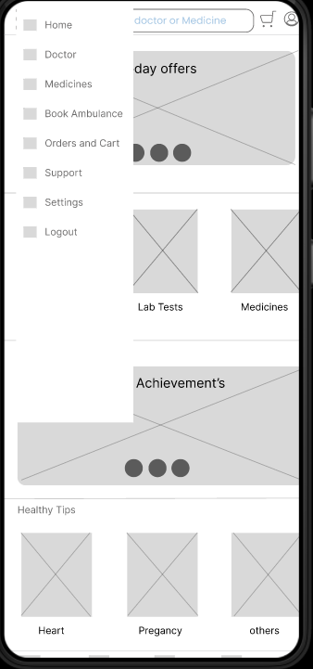
Mockups
Before usability study
After usability study
After the usability studies we found user seek for the suport tab in menubar so in case of urgency we can reach to near by hospital

Slide 18
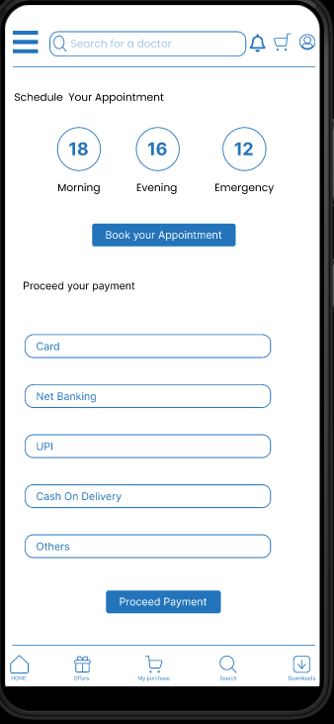
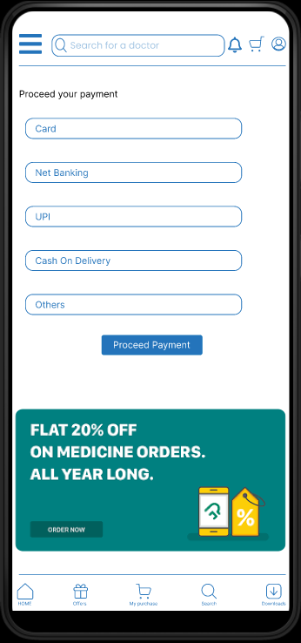
Mockups
Before usability study
After usability study
after the usability studies we found that there is 2 important funtions in one page which make user uncomfort o we mak new payment page

Slide 19
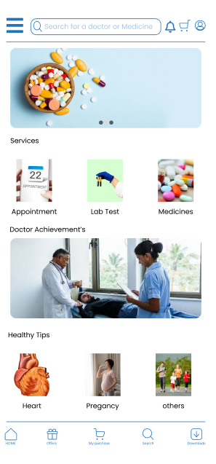
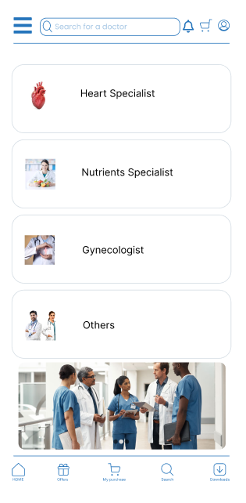
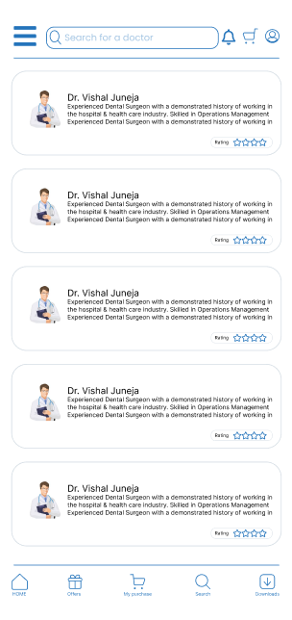
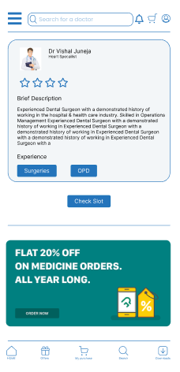
Mockups

Slide 20
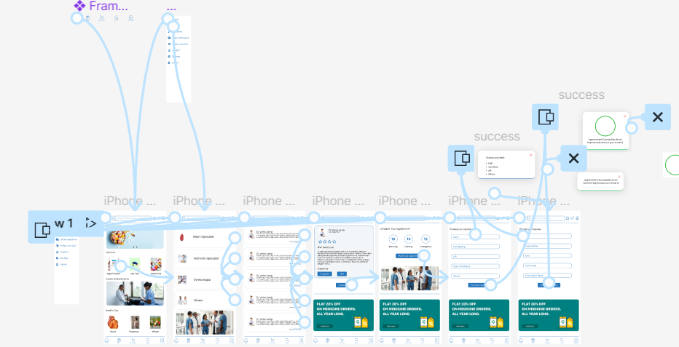
High-fidelity prototype
Medicose Health App High-Fidelity Prototype

Slide 21
Accessibility considerations
1
2
3
Provided access to users who are vision impaired through adding alt text to images for screen readers.
Used icons to help make navigation easier.
Provide the Dark and light mode options

Slide 22
Going forward
Takeaways
Next steps

Slide 23
Takeaways
Impact:
The app provide the eassy access of all the medical problems at one platform which makes user save time and availblity of all mecialcal need
What I learned:
While designing the Medicose Health app, I learned that the first ideas for the app are only the beginning of the process. Usability studies and peer feedback influenced each iteration of the app’s designs.

Slide 24
Next steps
1
2
Conduct another round of usability studies to validate whether the pain points users experienced have been effectively addressed.
Conduct more user research to determine any new areas of need.

Slide 25
Let’s connect!
Thank you for your time reviewing my work on the Medicose app! If you’d like to see more or get in touch, my contact information is provided below.
Email:-vishaljuneja198@gmail.com

Slide 26
Thank you!

